Slide 1
Mind Game : Reversi
Arunothia Marappan
13378

Slide 2
THE GAME AND ITS RULES

Slide 3
Rules :
Reversi is a two player board game and the players play the game alternatively.
A player is allowed to make only legal moves, that is only those moves which cause at least one flip of the opponent’s coin.
The game ends when both players end up having no more legal moves left.
The player with maximum number of his coins on board is declared as the winner.

Slide 4
Strategies :
If we notice, then we would find that a corner once occupied can never get flipped. This means a corner is a stable move, i.e., getting a corner is advantageous.
As in this game each move of the player is being influenced by the opponent’s move, we can force the opponent’s chance to get skipped.
Keeping the stability of different positions on the game board, We can assign them points, which will enable us to calculate the strategic score of the board at the last depth of search of the tree.

Slide 5
Strategic Score Table :
Square Type | Player | Opponent
Corner | +5 | -5
X-square | -2 | +2
C-square | -1 | +1
Sweet 16 | +2 | -2
Others | +1 | -1
Corner | +5 | -5

Slide 6
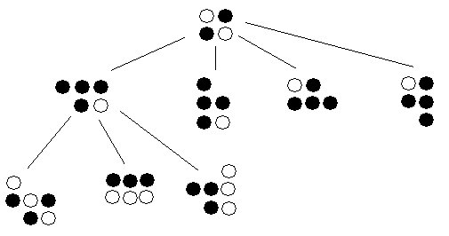
ALGORITHM USED
MIN_MAX Algorithm using lists
ALPHA_BETA Pruning using MIN_MAX on self referential class

Slide 7
Min_Max Algorithm
This is an algorithm which suits any game where the gain of one player is the loss of the other.
To maximize the score of the given player, we take the maximum of the score he can attain given that the opponent always plays the best move.
i.e. as we travel down the tree, the maximiser (computer in this case) will always take the maximum value of its children as its score where as, the minimiser (user in this case) will always take the minimum value of its children as its score.

Slide 8
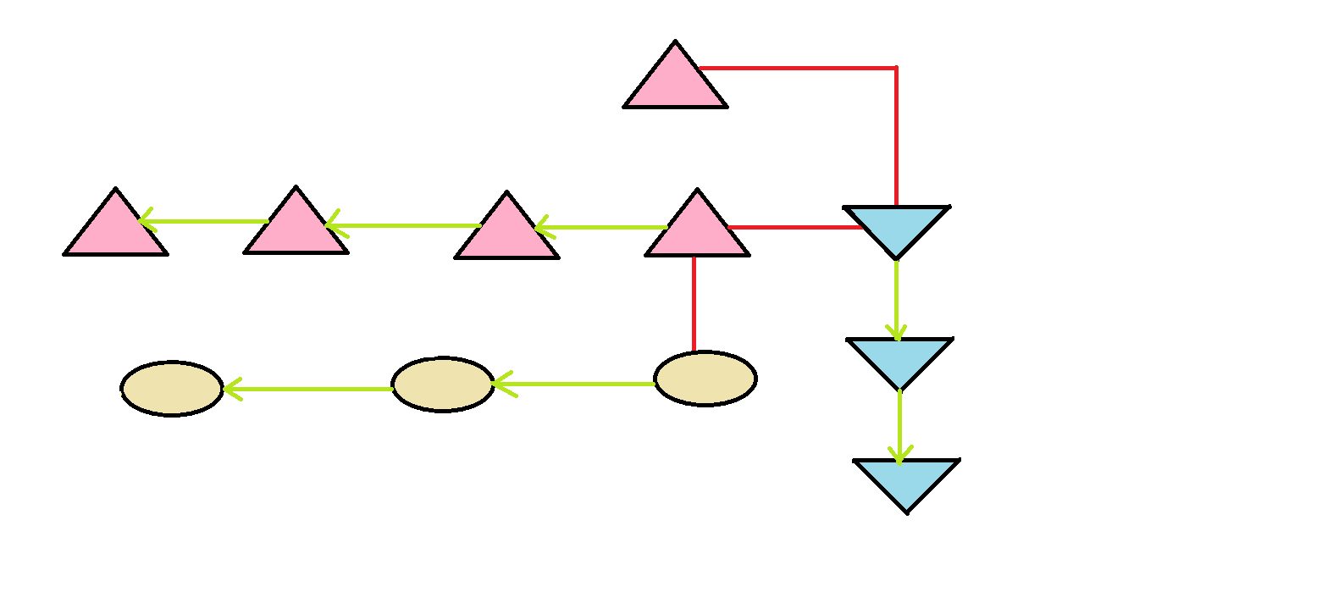
Min_Max Algorithm Implementation :
In my code, I have implemented Min_Max Algorithm using a tree similar to the one shown above.

Slide 9
Alpha_Beta Pruning
Works much faster than Min_Max because we prune away from branches which are not fruitful.
We use an extra variable called alpha (beta) which track the best value achieved by the maximiser (minimiser) along the way back to the root.
The moment we get to know that the value of maximiser can get greater than beta, we prune away from that branch because the minimiser will never allow this to happen. Similarly, when we get to know that the value of minimiser can get lesser than alpha, we prune away from that branch because again maximiser will never allow this to happen.

Slide 10
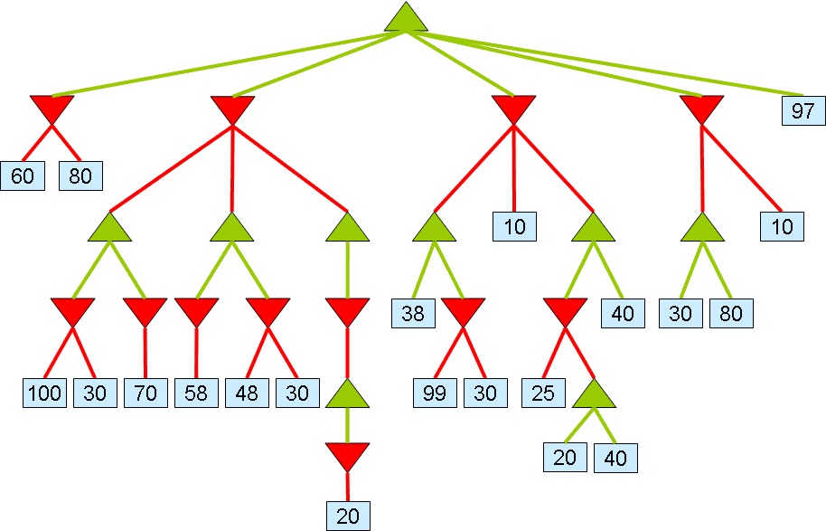
Alpha_Beta Pruning Example

Slide 11
Random Game Generator Report :
DEPTH | Min_Max Algorithm |  | Alpha – Beta Pruning
 | Time | Win % | Time | Win %
1 | 0.12 | 81.3 | 0.07 | 81.5
2 | 0.74 | 84.73 | 0.36 | 85.99
3 | 6.3 | 91.1 | 1.9 | 92
4 | 57 | 94 | 8.8 | 94.6
5 | 556 | 95 | 46 | 95.3
6 | 3200 | 97 | 178 | 98

Slide 12
Bar Graph : Time vs. Depth

Slide 13
Bar Graph : Win % vs. Depth

Slide 14
WELCOME TO THE WORLD OF REVERSI
PRESS
1 : FOR TWO PLAYER GAME
2 : FOR USER VERSUS COMPUTER GAME
3 : TO HAVE A RANDOM GAME GENERATOR TO PLAY AGAINST COMPUTER
ANY OTHER NUMBER TO QUIT
3
SELECT THE ALGORITHM WITH WHICH THE COMPUTER IS TO PLAY THE RANDOM GAME
PRESS
1 : MIN_MAX ALGORITHM
2 : ALPHA- BETA PRUNING DONE WITH MIN-MAX
2
ENTER THE DEPTH OF SEARCH U WANT
3
THE NUMBER OF GAMES YOU WANT TO RUN RANDOM :
1000
THE NUMBER OF WINS : 925
PERCENTAGE OF WIN : 92.5
THE TIME TAKEN FOR THIS EVALUATION : 13 SECONDS
WANT TO PLAY A FRESH NEW GAME?? (y/n) : n

Slide 15
WELCOME TO THE WORLD OF REVERSI
PRESS
1 : FOR TWO PLAYER GAME
2 : FOR USER VERSUS COMPUTER GAME
3 : TO HAVE A RANDOM GAME GENERATOR TO PLAY AGAINST COMPUTER
ANY OTHER NUMBER TO QUIT
2
THE USER IS ALSO GIVEN THE CHOICE TO SELECT THE COLORS OF THE COINS OF
USER AND COMPUTER

Slide 16
PRESS
1 : BLUE
2 : GREEN
3 : CYAN
4 : RED
5 : MAGENTA
6 : BROWN
7 : LIGHTGREY
8 : DARKGREY
9 : LIGHTBLUE
10: LGHTGREEN
11: LIGHTCYAN
12: LIGHTRED
13: LIGHTMAGENTA
14: YELLLOW
15: WHITE
COLOUR FOR USER : 2
COLOR FOR COMPUTER : 4
ENTER THE DEPTH OF SEARCH U WANT
6

Slide 17
CHOSE THE ALGORITHM YOU WOULD LIKE THE COMPUTER TO FOLLOW
PRESS
1: MIN-MAX ALGORITHM
2: ALPHA- BETA PRUNING DONE WITH MIN-MAX
2

Slide 18
THE CHOICES AVAILABLE FOR USER (PLAYER 1)
1th CHOICE : X : 3 Y : 4
2th CHOICE : X : 4 Y : 3
3th CHOICE : X : 5 Y : 6
4th CHOICE : X : 6 Y : 5
USER SHOULD ENTER HIS/HER POSITION :
x : 3
y : 4

Slide 19
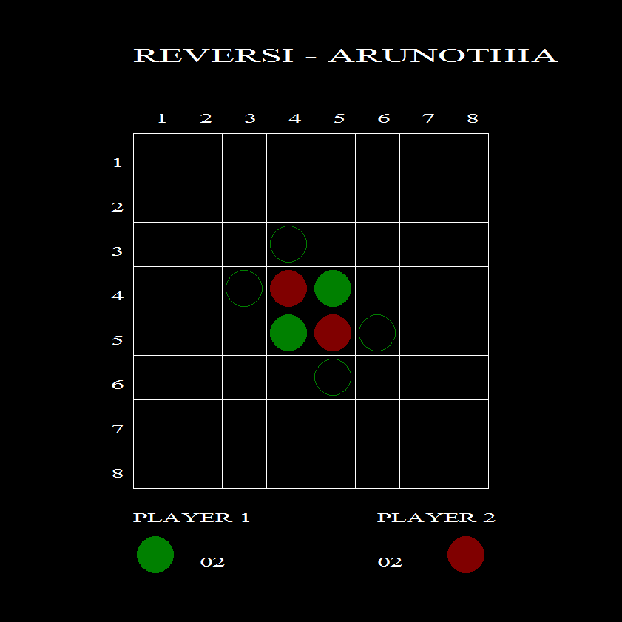

Slide 20
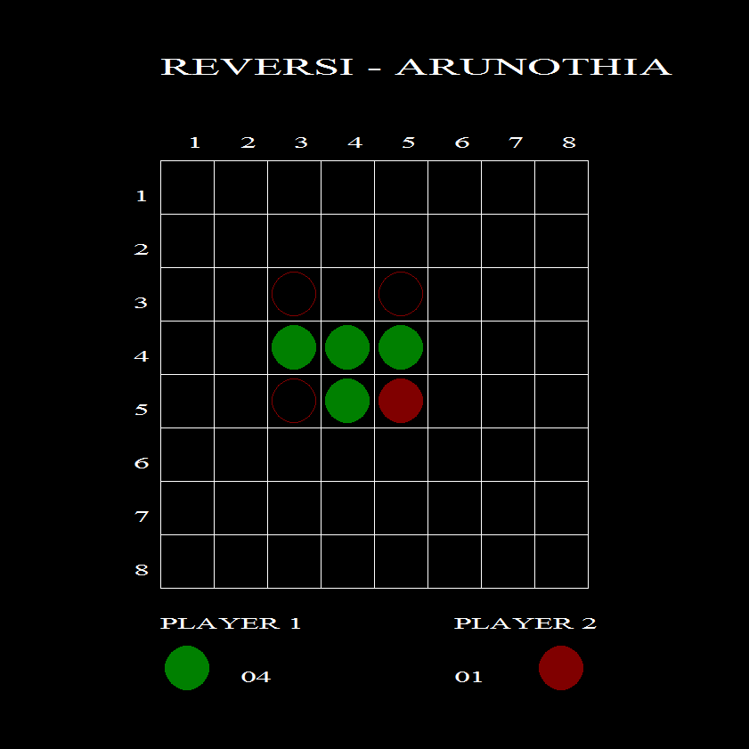

Slide 21
